Slide 1
Final review day minor project automatic water supplier for plants
Presented by :
u.s.Varshini
d.subhika
p.Srinithi
p.subasree
Guided by:
mRS.t.abirami

Slide 2
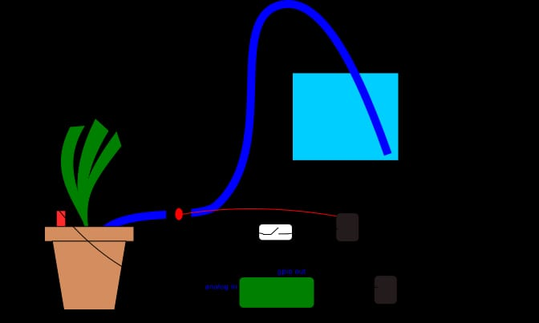

Slide 3
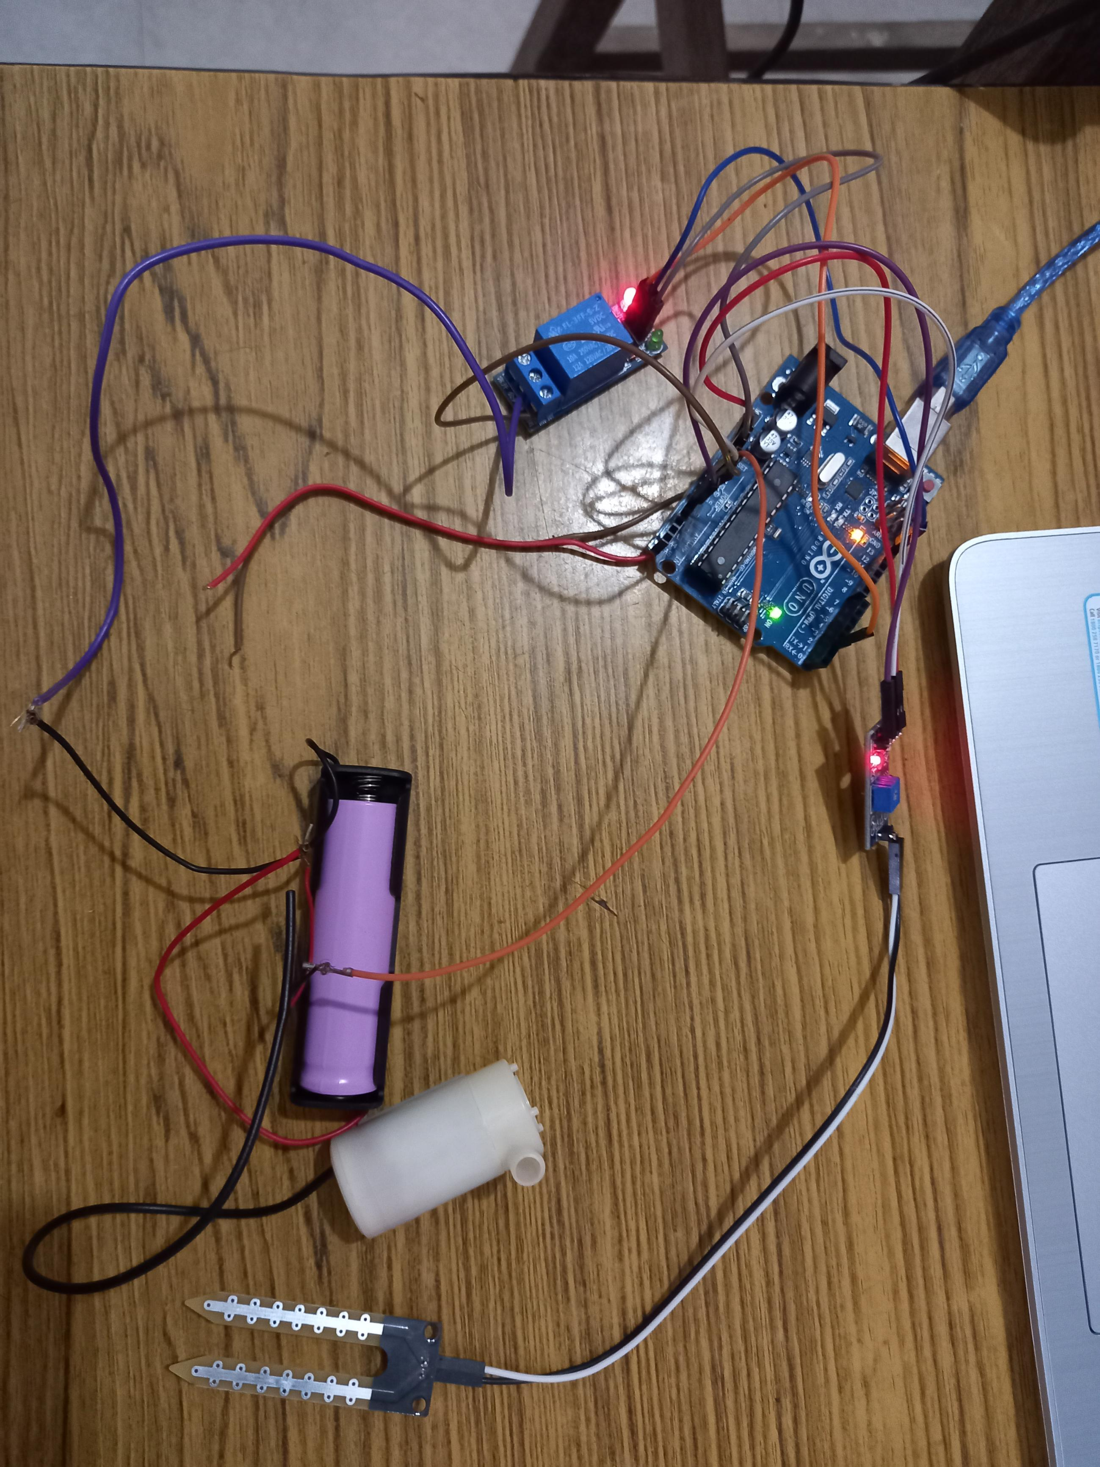
CIRCUIT DIAGRAM

Slide 4
components
Arduino UNO board
Soil moisturiser
Pump
Servo motor
Battery
Relay module

Slide 5
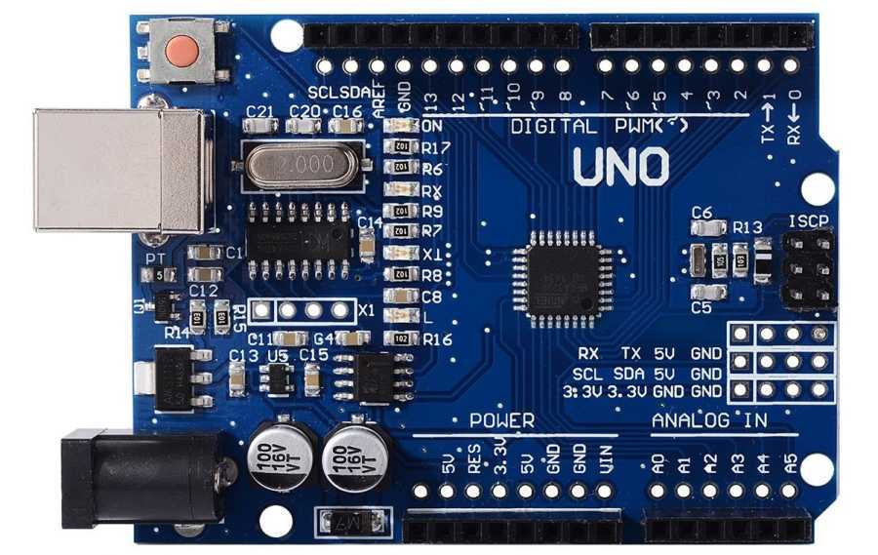
ARDUINO UNO BOARD
It is an microcontroller
Uses ATmega328 as a controller
Open source electronic platform
Turns on/off the supplier

Slide 6
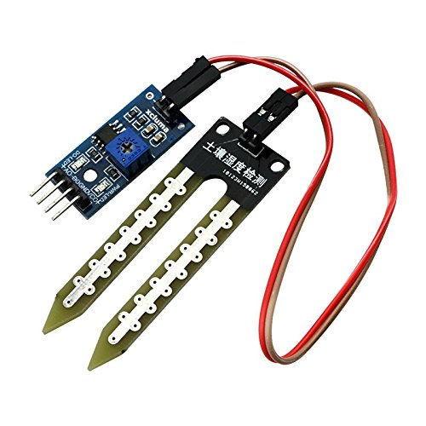
SOIL MOISTURE SENSOR
Module has 2 probes
Has an LM393 high precision comparator
One probe is connected to the arduino which senses the water level
Produces an analog voltage output according to the resistance

Slide 7
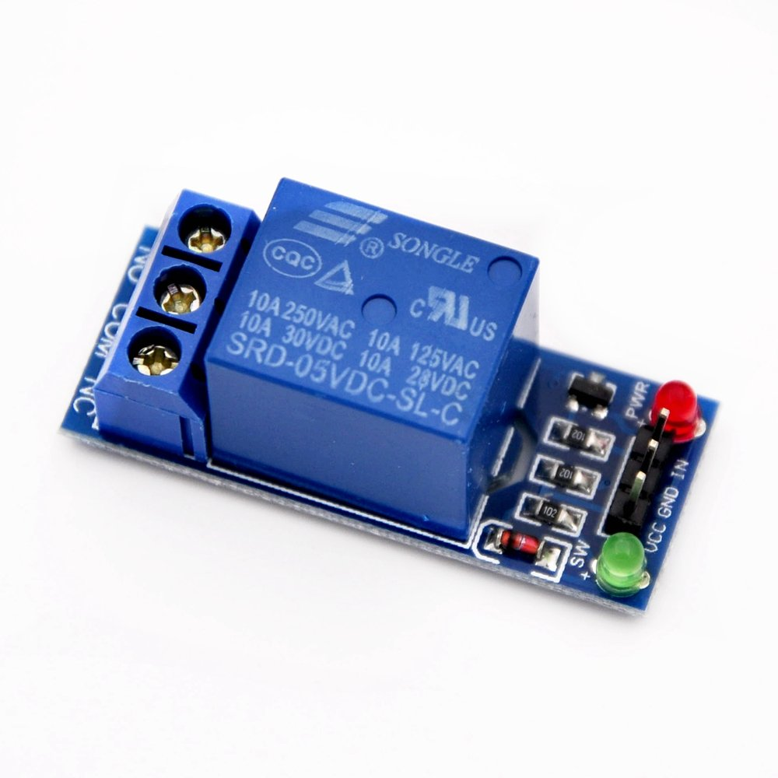
Relay module
Ensures proper irrigation
Turns off when there is a sufficient supply
works according to the threshold value

Slide 8
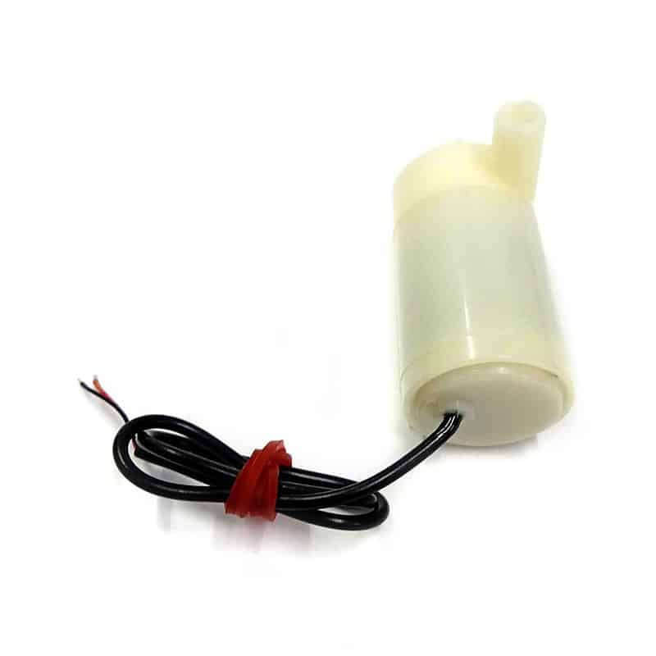
Pump
Supplies water to the plants
Works as a motor

Slide 9
Overall work
Maintains constant water pressure
Ensures the water is delivered with force to reach all the plants
Used to increase efficiency of water distribution
Saves time and effort in manual watering

Slide 10
Advantages
Reduced labour
Timely irrigation
Extends the life of plants
Maintains humidity level
Can control this during rainy season

Slide 11
DISADVANTAGES
Requires high maintenance
Lack of human touch
Has only limited flexibility
High consumption of electricity

Slide 12


